Slide 1



Referral Portal Onboarding
Training for Referring Practices and Providers

Slide 2
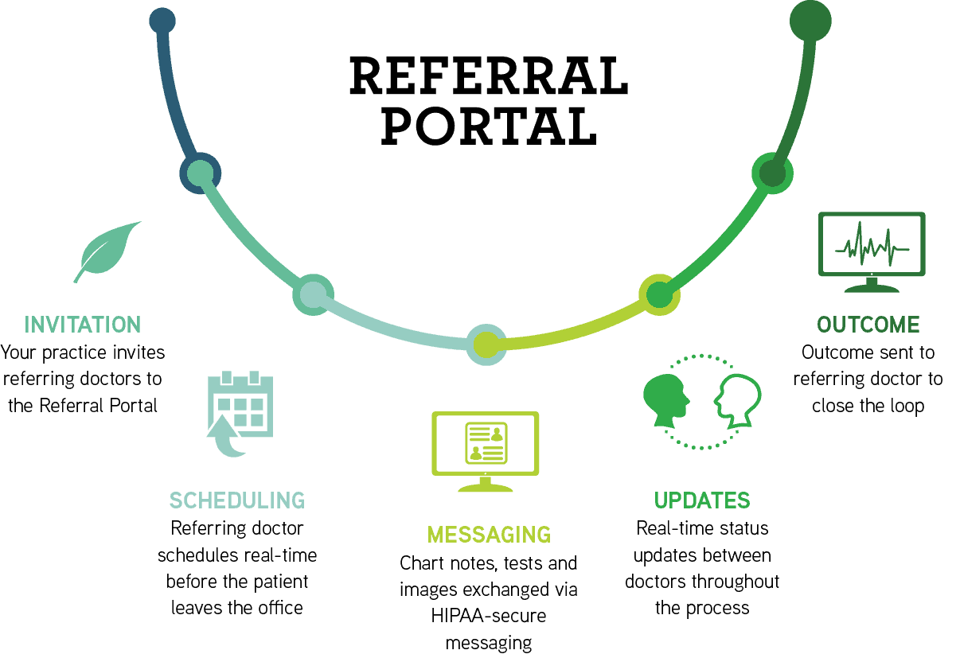
Portal Overview

Slide 3
Benefits of The Referral Portal
Fast and Simple Referring
Improved Communication Between Our Practice and Yours
Enriched Patient Experiences by Enhancing Coordination of Care

Slide 4
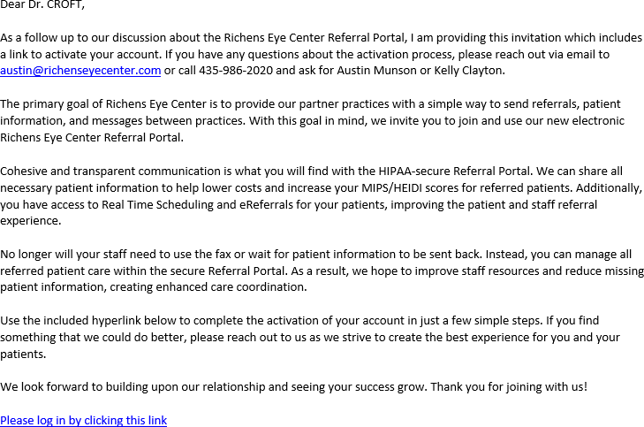

Invitation Sent by Email

Slide 5
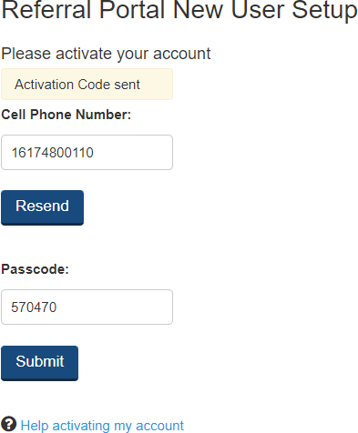
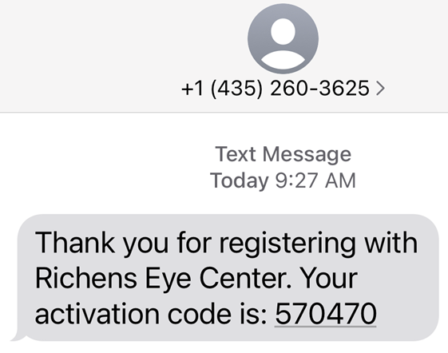
Activation Code Sent Via Text
Step 1:
Enter your cell phone number and hit send.
The activation code is sent almost immediately!
Step 2:
Enter the activation number and you will be taken to the Activate Your Account landing page.

Slide 6
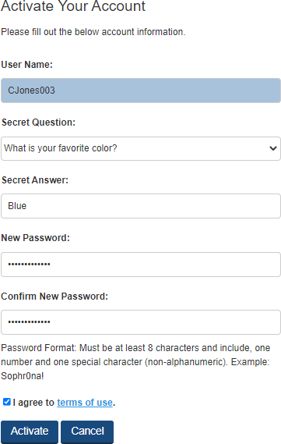
Activate Your Account
The username is automatically assigned and is not able to be changed.
You will select a secret question, enter your secret question answer and set your new password.
Agree to the terms of use by checking the box.
Click on “Activate.”
Upon successful activation the you will be taken to the log in page.

Slide 7
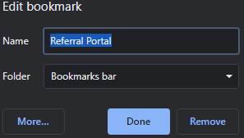
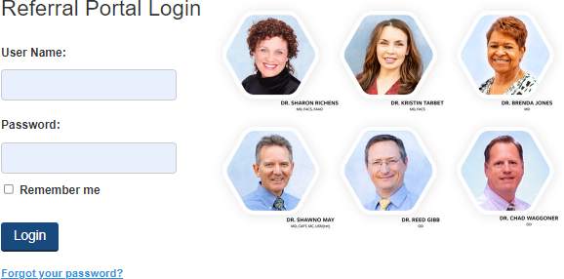
Save Site To Your Favorites
Step 1:
Copy and paste this url into the address field of your web browser:
https://www2.referralgateway.net/sopRefMgr_Login.aspx?clinic=rch1 Recommended web browser is Chrome
Step 2:
Before entering the user credentials that you created while activating your account, save the site to your favorites.
We recommend that you rename the bookmark as Referral Portal.
STEP 3:
Enter your credentials, check the Remember Me box and click on the Login button.

Slide 8
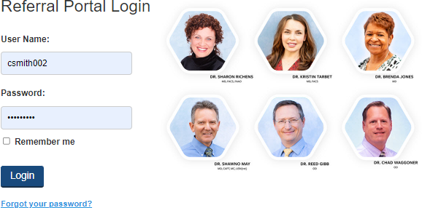
Log In Landing Page
Use the “Forgot your password?” button to recover a forgotten password.
The temporary password will be emailed to the email address associated with the account.
Users with Admin permissions can reset a user's password.

Slide 9
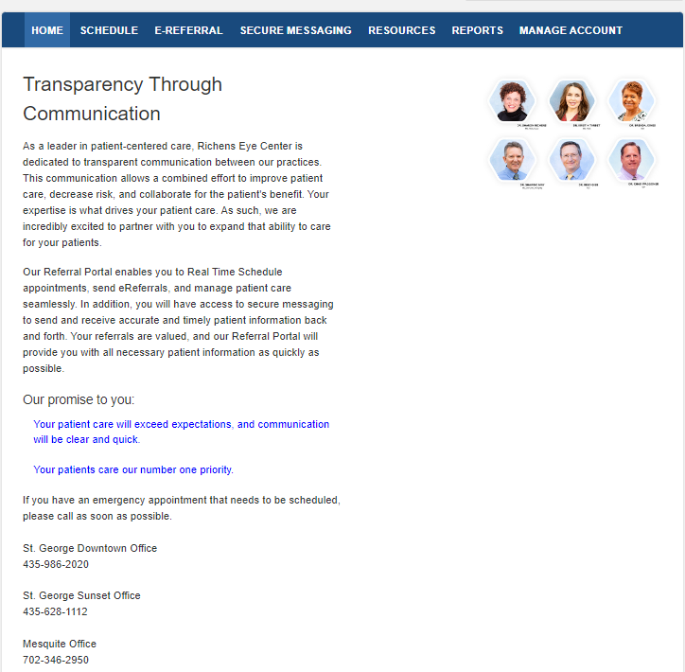
Home Page

Slide 10
Navigation Menu
Home Home page of the Referral Portal.
Schedule Real Time scheduling (RTS) of the patient with the specialist.
eReferral Request for specialist practice to schedule the patient.
Secure Messaging Compose, send, receive and manage secure messages.
Resources Documents provided as resources for the referring providers and their patients.
Reports Access to reports for only the patients referred to the specialist by the referring practice.
Manage Account Allows individual users to reset their password or security question.
Admin user has access to add non-provider users, deactivate users and reset passwords.

Slide 11
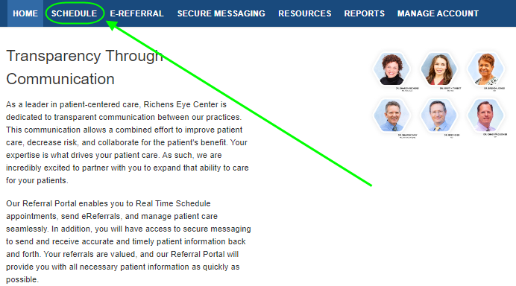
Real Time Scheduling (RTS)
From the HOME page, click on SCHEDULE

Slide 12
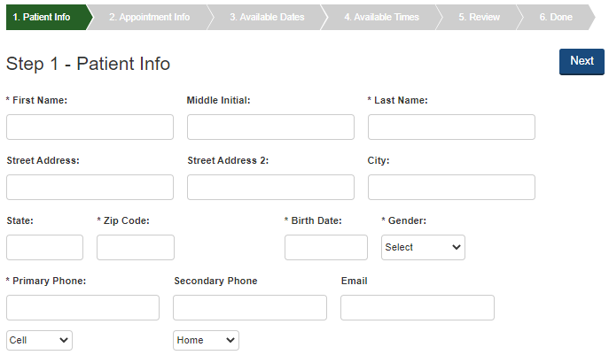
Enter The Patient’s Information
Items marked with an asterisk are required. When possible, please enter the data for all fields as that reduces the need to contact the patient.
By entering the patient’s email address, the patient will receive an email confirmation of the referral with important information.

Slide 13
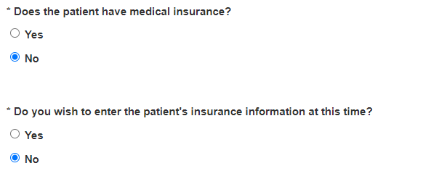

Enter Insurance Information
You may mark that the patient has insurance, but bypass entering the information if you will be sending a copy of the patient’s insurance card by secure messaging.
Please be sure to include the front and back of the card when sending a copy.
We want your patient’s experience with our office to be exceptional. By providing complete information the communication between our practices will provide the patient with seamless care.

Slide 14
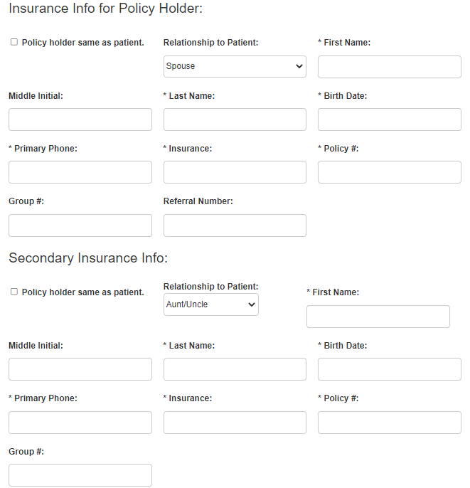
Policy Holder Information
By checking Policy holder same as patient, the data entered on the previous screen will populate appropriately.
Please be sure to provide a referral number where appropriate.

Slide 15
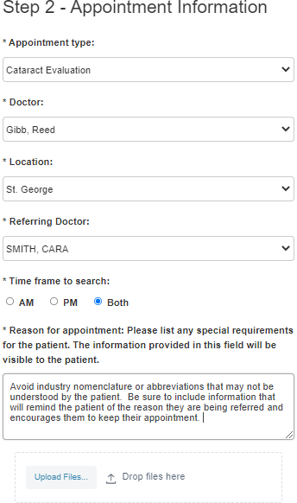
Appointment Information
If there are specific instructions, they will appear as a pop-up message below the Previous and Next buttons.
First Available can be selected for the Doctor, the Location or both. When selected, the calendar will provide a selection of appointments to choose from where the provider and location will be displayed.
Attachments can be added to the referral during the scheduling process by either uploading files or by drop and drag method.

Slide 16
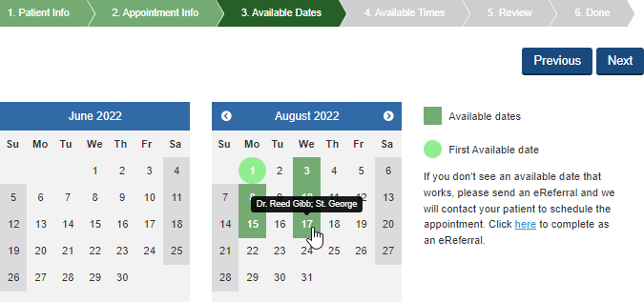
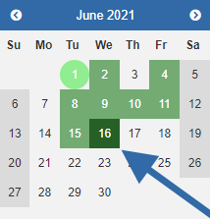
Select The Appointment Date
When First Available is selected, hovering over the available dates will allow you to see the provider and location availability for that specific date.
Once a date is selected it will be displayed in a darker shade of green.
Use eReferral feature if available dates do not meet the needs of your patient. The patient data that was previously entered will be saved.
Once date is selected click Next to continue to time selection.

Slide 17
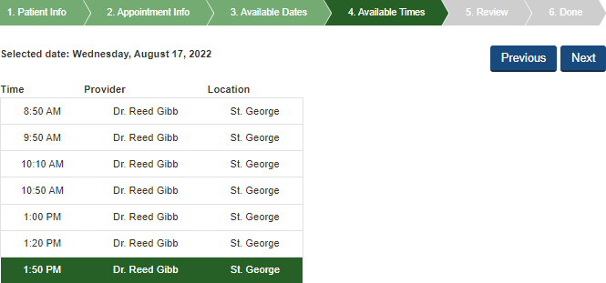
Select The Appointment Time
Once a time is selected it will be displayed in a darker shade of green.
Click Next to review the appointment details before scheduling.

Slide 18
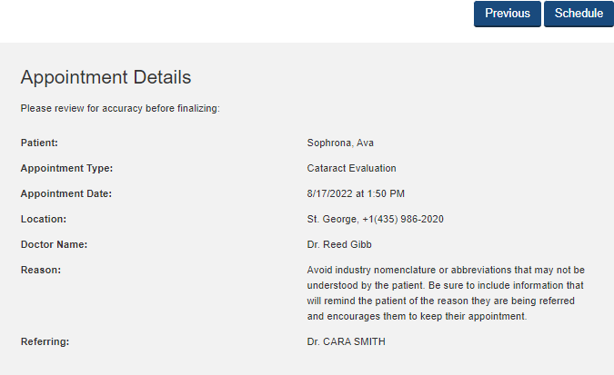
Review The Appointment Details
Carefully review the information listed in the Reason field to ensure it is accurate.
Click on Schedule to proceed with scheduling the appointment.

Slide 19
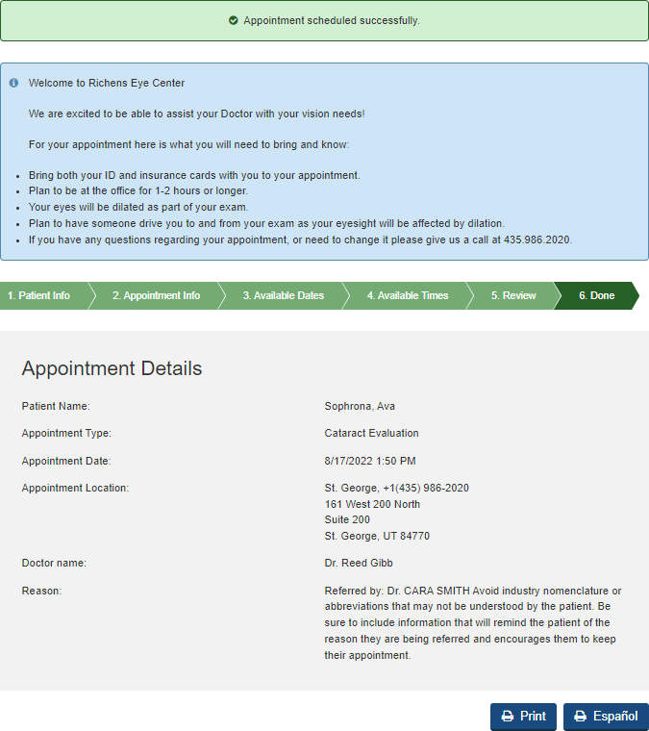
Patient’s Appointment Card
A validation message in green will confirm that the appointment was successfully scheduled.
Review the reminders for the appointment that are found in the blue box with the patient.
The appointment card can be printed in English by clicking on Print.
To provide the appointment card in Spanish, click on Spanish. The copy will be displayed in Spanish then click on Imprimir to print the appointment card.

Slide 20

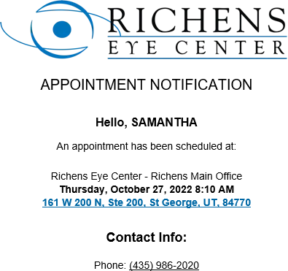
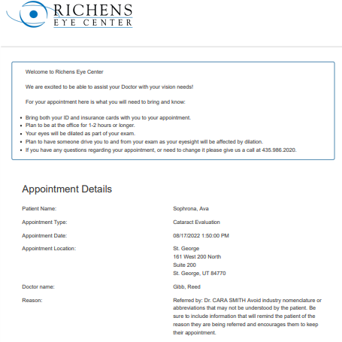
Patient Reminders
Printed Appointment Card
Emailed Appointment Confirmation
This reminder will be sent to the patient as soon as the appointment is scheduled.
Our practice will also remind the patient of their appointment through our appointment reminder system.

Slide 21
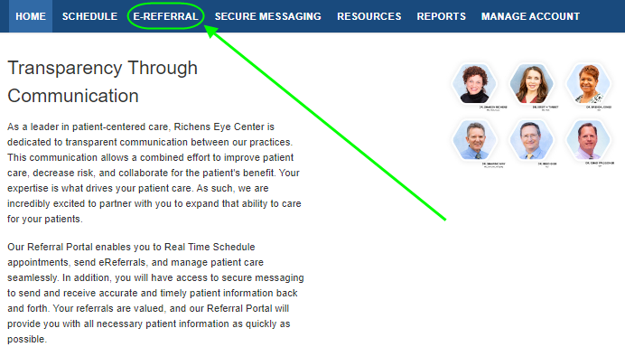
eReferral
From the HOME page, click on eReferral
Once we have received the eReferral, our practice will contact the patient to schedule their appointment.

Slide 22
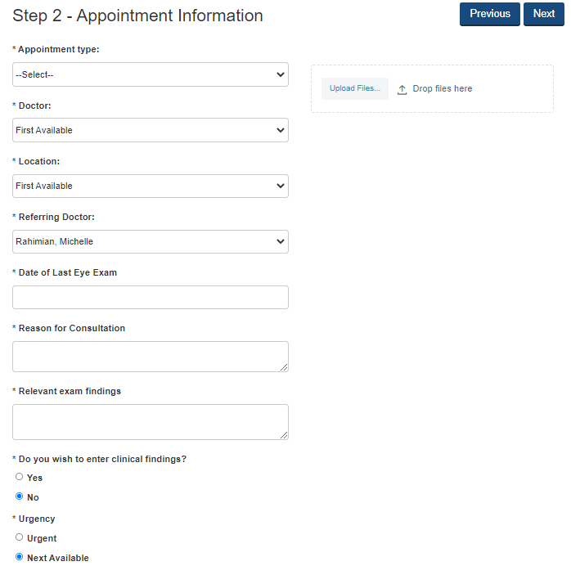
Step 1: Enter the patient’s information just as you would for RTS appointment.
Step 2: Complete the appointment details by making selections from the provided drop-down menus.
Step 3: Enter the Date of the patient’s last Eye Exam.
Step 4: Provided a comprehensive Reason for Consultation to help our staff schedule the patient appropriately.
Step 5: Relevant exam finding can be entered or simply enter “see attached” if office notes, test results or a referral letter will be attached to the referral.
Step 6: Clinical findings can be entered by checking the yes box. Additional fields will be displayed for completion.
Step 7: Urgent – Patient will be scheduled in the next 5 to 7 business days.
Next Available – will be next available based upon appointment details selected.
Step 8: Upload desired files such as clinical notes, patient forms or insurance card images to be sent with the referral. Note: additional information may be sent via secure messaging.

Slide 23
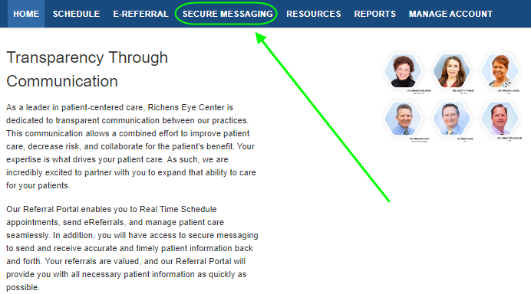
Secure Messaging
Secure Messaging is easy to use and employs encrypted technology to protect Patient Health Information to ensure HIPAA compliance.
Attachments are also encrypted allowing us to share key information for the coordination of patient care.
From the HOME page, click on Secure Messaging

Slide 24
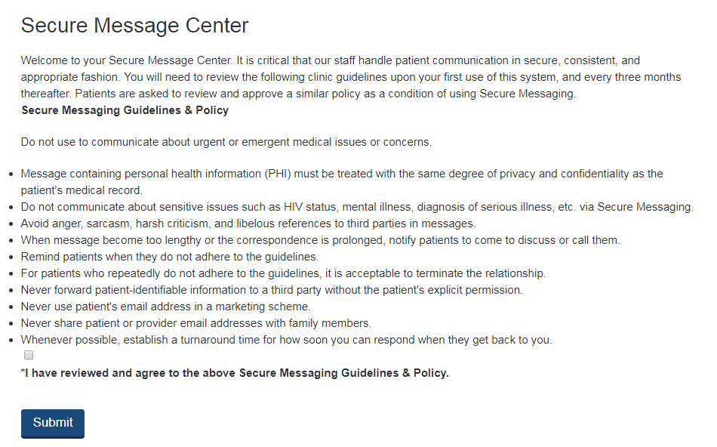
Guidelines & Policy
The Secure Messaging Guidelines & Policy must be agreed to for you to take advantage of this very useful feature.

Slide 25
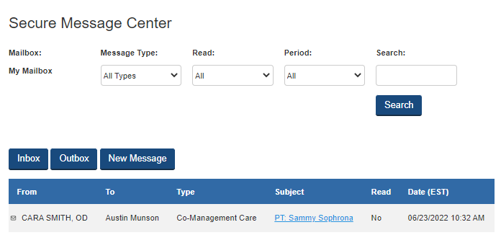
Secure Message Center
The Secure Message Center looks and functions very similar to email.
Using Secure Messaging to send patient information between our practices will ensure that we are communicating in a manner to protect the patient’s health information.
To read a message simply click on the Subject to open the message.
Once the message is open click on Respond to reply to the message.

Slide 26
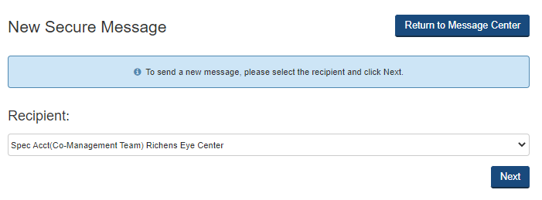
Initiating A New Secure Message
Click on New Message from within the Message Center.
Select a Recipient from drop down menu and then click Next

Slide 27
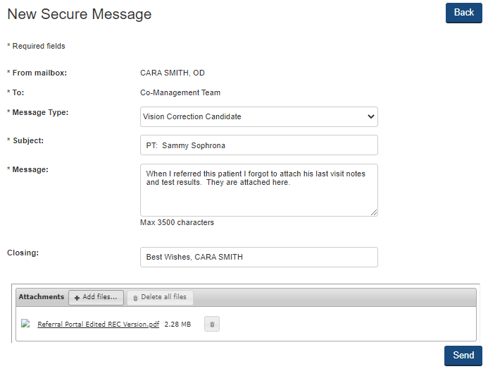
Composing a New Secure Message
Select a Message Type from the drop-down menu.
For the Subject we recommend referencing the patient’s name and what the secure message pertains to as this will make it easier to review and search secure messages.
Attachments with irregular file extensions may be blocked or fail to send. Please contact our office directly if this occurs as the parameters can be adjusted to meet your needs.

Slide 28
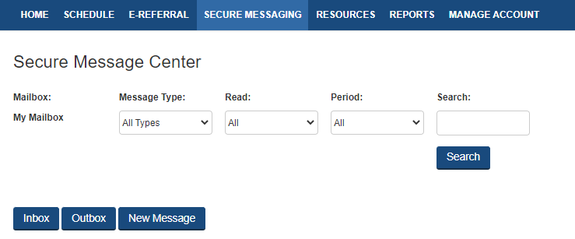
Secure Message Outbox and Filters
The Outbox will display all message that have been sent and they are retained in the Outbox until you delete them.
Use the filters to define the details to be displayed or to Search for a specific patient.

Slide 29
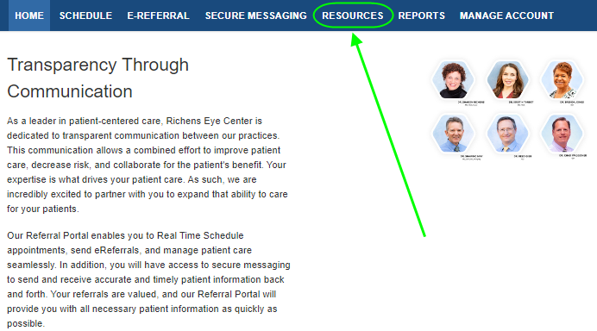
Resources
From the HOME page, click on Resources

Slide 30

Current Resource Library
This represents the current list of documents provided in the Resources section.
If you have suggestions for additional items you wish to have added, please let us know!

Slide 31
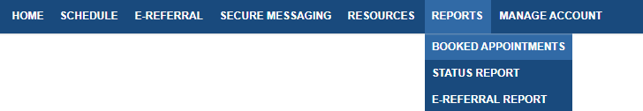
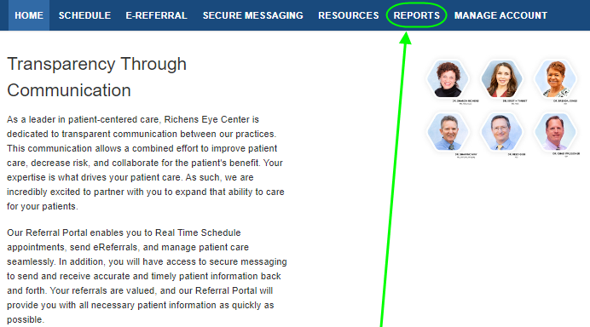
Reports
Status Report is a live report that provides the current status of your referred patients. This report will include referred patients that were scheduled using Real Time Scheduling and eReferrals once they are scheduled by our practice.
Booked Appointments lists all appointments booked through the Referral Portal. This report does not update the status of the appointment. The appointment displayed on this report will be the original date of the appointment.
eReferral Report lists all appointments booked through the eReferral process.
From the HOME page,
click on Reports

Slide 32
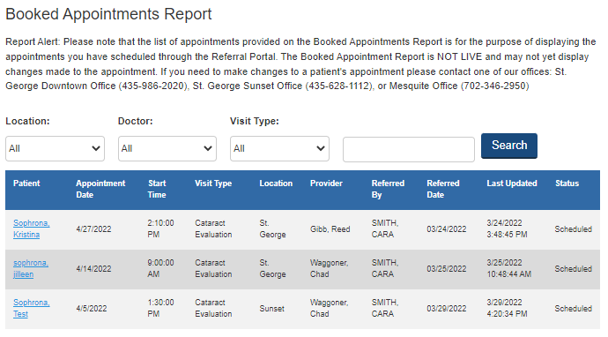
Booked Appointments
The filters will allow customization of the data to be viewed.
The Search filter will allow you to search for a particular patient.
This report contains only patient that were Real Time Scheduled.

Slide 33
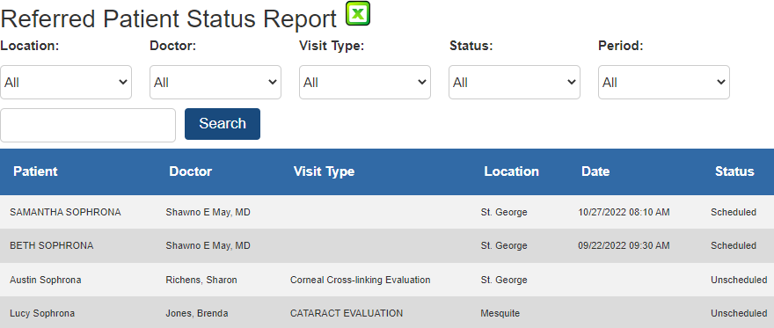
Referred Patient Status Report
The filters will allow customization of the data to be viewed.
Patients that do not have a future appointment with the specialist’s practice will be highlighted in red. This is to help your practice identify patients that should be scheduled for follow up with your practice.
The report updates each time it is opened.
The data can be exported into Excel.
The download or print icons will provide access to the referral letter for a particular appointment.
Please note the Visit Type field will be blank due to the complexities of our scheduling. See the Booked or eReferral Reports for exact visit type for the referred patient.

Slide 34
Referral Letter Sample

Slide 35
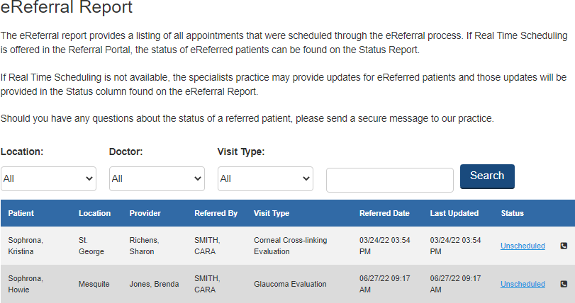
eReferral Report
The filters will allow customization of the data to be viewed.
The report updates each time it is opened.
If present, the Phone Icon indicates that a call(s) has been made to the patient to schedule their appointment and there are notes to view.
Click on the Status of a specific patient to view the notes.

Slide 36
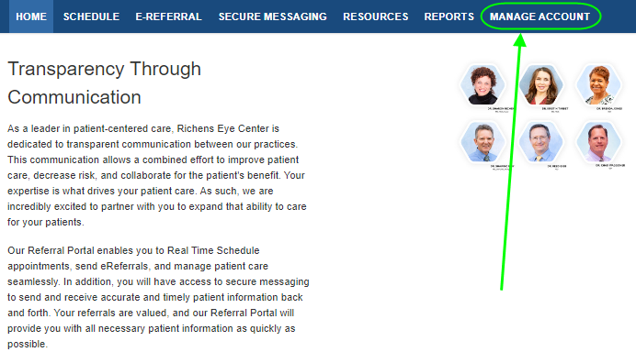
Manage Account
From the HOME page,
click on Manage Account

Slide 37
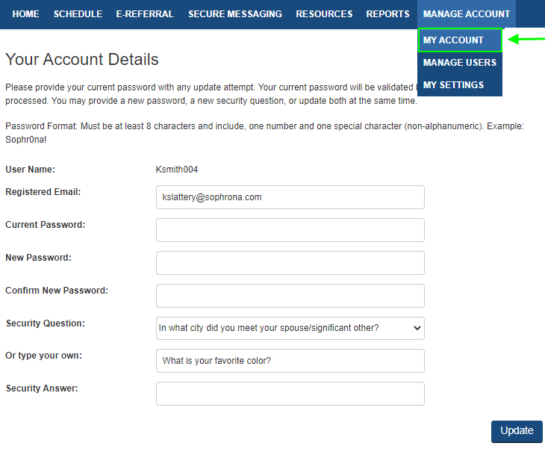
My Account
Individual users have access to change their email address, password, security question and answer.

Slide 38
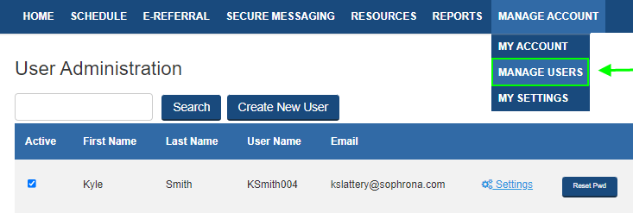
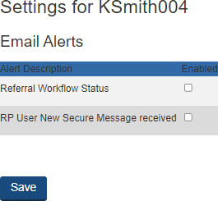
Manage Users
Only Referral Portal users with Admin permissions will be able to access the Manage Users section.
DO NOT add providers here or use their names when creating providers.
A user’s Email Alerts can be turned on or turned off by clicking on Settings. Check the box next to the alerts to be turned on.
A user’s password can be reset by clicking on Reset Pwd. The new temporary password will be emailed to the address listed for the account. The user will be prompted to set a new password when they log in with the temporary password.

Slide 39
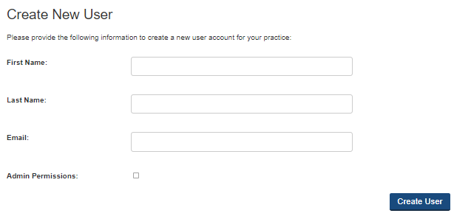

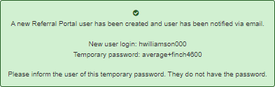
Create New User
Select Create New User.
Enter the required data and check the Admin Permissions box if you wish to grant access to the Manage Users section of the Referral Portal to the new user.
A confirmation pop up will appear with the new user’s credentials. This information will be sent to the new user via email.

Slide 40
Thank you in advance for utilizing our Referral Portal!
Austin Munson
austin@richenseyecenter.com
435.986.2020
richenseyecenter.com

